Slide 1


Green Pace
Security Policy Presentation
Developer: James Soto

Slide 2

OVERVIEW: DEFENSE IN DEPTH
Defense in depth (DiD) is a security strategy that involves using multiple layers of security controls to protect a system or network. The goal of DiD is to make it as difficult as possible for an attacker to gain access to sensitive data or aspects of the systems. The benefit of using DiD is that it helps mitigate the risk of one point of failure in a security breach. Instead, the system contains multiple layers that prevent the attacker from gaining access to the vulnerable part of the system. Another benefit of DiD is that containing multiple layers, slows down the attack, giving the company the ability to track and patch any issues within the system. The drawbacks of having a system like DiD in place is that it could be more expensive to implement and maintain by becoming more complex which could hinder the team’s productivity and efficiency when they are trying to patch an issue or trying to access different systems or data. How deep is to deep is a question that depends on how valuable the system or data that the organization is trying to protect or if the organization is at a high risk of attack. When implementing a system that contains DiD, the organization needs to consider that a more complicated overly layered system will cost more resources and financing to operate.

Slide 3

THREATS MATRIX
Likely Threats Risk is more likely to occur STD-STR51-CPP STD-STR02-CPP STD-MEM56-CPP STD-CTR51-CPP | Priority High risk threat needs attention STD-STR51-CPP STD-STR02-CPP STD-MEM56-CPP STD-CTR51-CPP
Low priority Risk has a low chance of a threat/Probable Likelihood STD-STR52-CPP STD-CTR53-CPP STE-ERR50-CPP | Unlikely Risk is unlikely to occur STD-DCL03-CPP STD-DCL59-CPP STD-STR53-CPP

Slide 4
10 PRINCIPLES
1.) Validate Input Data from Unverified Sources | Treat all data from external and unverified sources as untrusted until the information has been validated and sanitized. | STD-STR52-CPP - STD-CTR53-CPP - STD-CTR51-CPP
2.) Limit the scope of functions and variables | The smaller the scope, the less chance of unauthorized access and the misusing of the functions and variables. | STD-CTR53-CPP - STD-STR51-CPP - STD-CTR51-CPP - STD-STR53-CPP
3.) Use Smart Pointers | In C++ raw pointers could lead to memory leaks and dangling pointers if they are not handled correctly. To prevent this from, use smart pointers as shared_ptr or unique_ptr that automatically manage memory leaks. | STD-STR52-CPP - STD-MEM56-CPP - STD-CTR51-CPP
4.) Prefer standard library functions | C++ offers an extensive standard library that has been tested, optimized, is stable and well maintained over other libraries or self-created implementations. | STD-STR02-CPP - STD-DCL03-CPP - STD-CTR51-CPP - STD-DCL59-CPP - STD-STR53-CPP
5.) Regularly Patch and Update | Ensure that all compilers, libraries, and tools are patched and up to date, which will help protect the code from vulnerabilities.
6.) Use const correctly | Declare pointers and variables as const whenever possible to ensure that they can’t be modified or manipulated. | STD-STR52-CPP - STD-CTR53-CPP - STD-STR51-CPP - STD-DCL59-CPP - STD-STR53-CPP
7.) Sanitize All Inputs | Validate and sanitize all input data before the data is used. This will help prevent attacks such as buffer overflows and SQL injections. | STD-STR51-CPP - STD-STR02-CPP - STD-CTR51-CPP - STD-DCL59-CPP - STD-STR53-CPP
8.) Limit the use of dynamic memory | Dynamic memory allocation could lead to problems including memory leaks and heap corruption. Use automatic variables that get cleaned up when they go out of scope. | STD-STR51-CPP - STD-STR02-CPP - STD-CTR51-CPP
9.) Minimize the use of Global Variables | Global variables can be accessed and modified by any part of the code, which could lead to security vulnerabilities and/or unexpected behavior. When possible, use local variables and pass them as functions. | STD-STR51-CPP - STD-STR02-CPP - STD-MEM56-CPP - STD-DCL59-CPP - STD-STR53-CPP
10.) Avoid buffer overflows | C/C++ does not perform automatic bound checking on arrays which could lead to buffer overflow vulnerabilities. Always ensure that the array size is checked against the index being accessed. To avoid buffer overflow, ensure that writing and reading is not past the end of the array. | STD-CTR53-CPP - STD-STR02-CPP - STD-CTR51-CPP - STD-STR53-CPP

Slide 5
CODING STANDARDS
Coding Standard | Label | Name of Standard
Data Type | STD-STR52-CPP | Use valid references, pointers, and iterators to reference elements of a basic string
Data Value | STD-CTR53-CPP | Use valid iterator ranges
String Correctness | STD-STR51-CPP | Do not attempt to create a std::string from a null pointer
SQL Injection | STD-STR02-CPP | Sanitize data passed to complex subsystems
Memory Protection | STD-MEM56-CPP | Do not store an already-owned pointer value in an unrelated smart pointer
Assertions | STD-DCL03-CPP | Understand the termination behavior of assert() and abort()
Exceptions | STD-ERR50-CPP | Do not abruptly terminate the program
Data Structures | STD-CTR51-CPP | Use valid references, pointers, and iterators to reference elements of a container.
Declarations | STD-DCL59-CPP | Do not define an unnamed namespace in a header file
Strings | STD-STR53-CPP | Range check element access

Slide 6
ENCRYPTION POLICIES
Encryption in rest | Encryption at rest is designed to prevent the attacker from accessing the unencrypted data by ensuring the data is encrypted onto a hard drive, flash drive, or cloud storage. If the storage medium or system is attacked and compromised, encryption at rest ensures that the data remains inaccessible without the decryption keys.
Encryption at flight | Encryption at flight is the process of encrypting data that is being moved or transmitted between systems or over a network. Using encryption while the data is in transit ensures that the data can not be intercepted and read without the encryption keys.
Encryption in use | Encryption in use is data that is accessed or used by a user or an application. This is when the data is the most vulnerable, requiring the system to have good authentications in place to ensure the data is not compromised by an outside entity.

Slide 7
TRIPLE-A POLICIES
Authentication | Authentication is the process of verifying the identity of the user, a device, or the system. To authenticate a user and allow access to the system the authentication process involves checking the credentials of the user. Some systems might have added security measures in place like two-factor authentication or biometrics.
Authorization | Authorization occurs after the user is authenticated, and determining what that user could do inside of the system. Every user will have permissions and rights determining what resources that user could access.
Accounting | Accounting is the process of keeping track and monitoring the resources the user accessed and what they did. Accounting collects a record of what databases were accessed and what the user did inside those databases. This provides a record of every user and could be used in the event of a compromise from within the company.

Slide 8
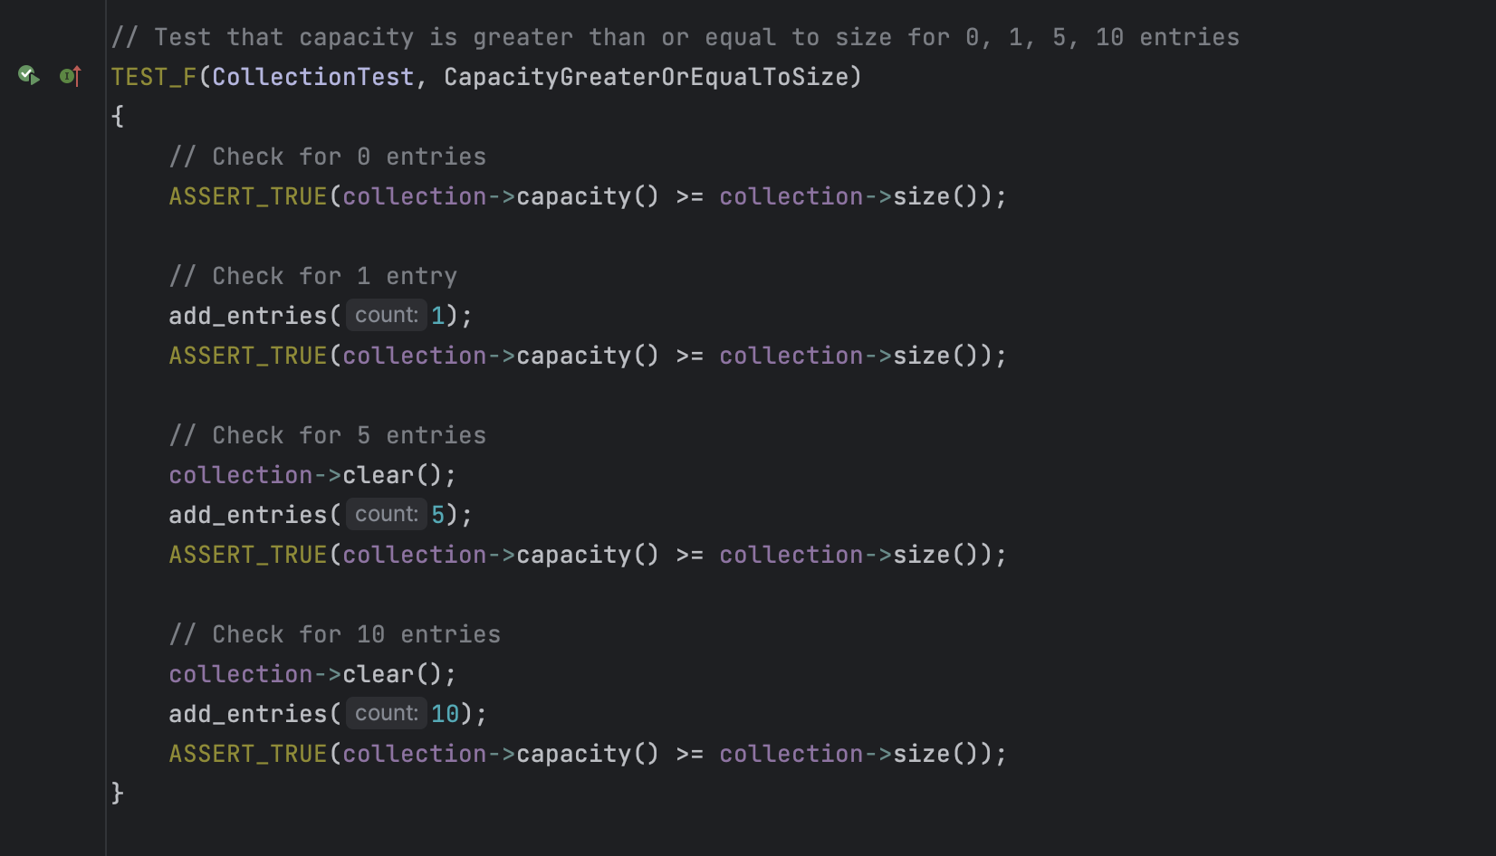
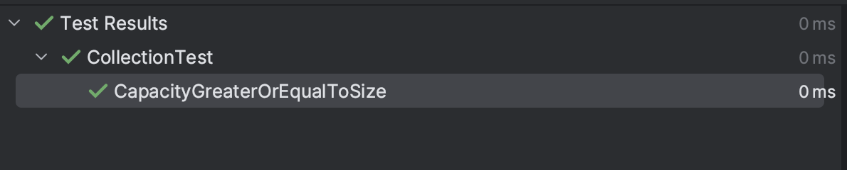
Unit Testing: CapacityGreaterOrEqualToSize
This Unit Test checks that the capacity is greater than or equal to sizes 0, 1, 5, and 10 entries

Slide 9
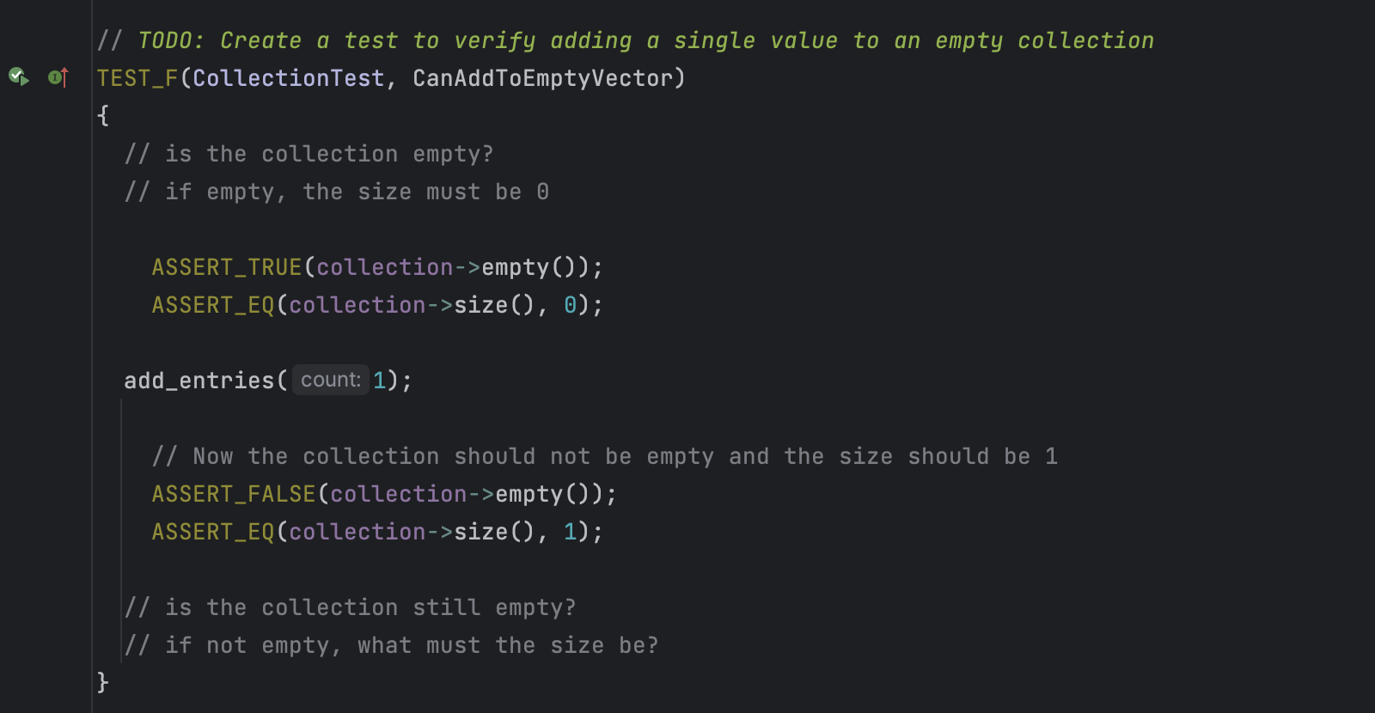
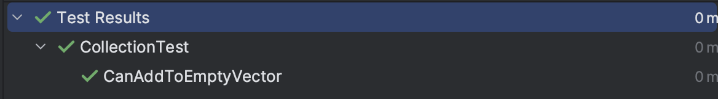
Unit Testing: CanAddToEmptyVector
This Unit Test verifies adding a single value to an empty collection

Slide 10
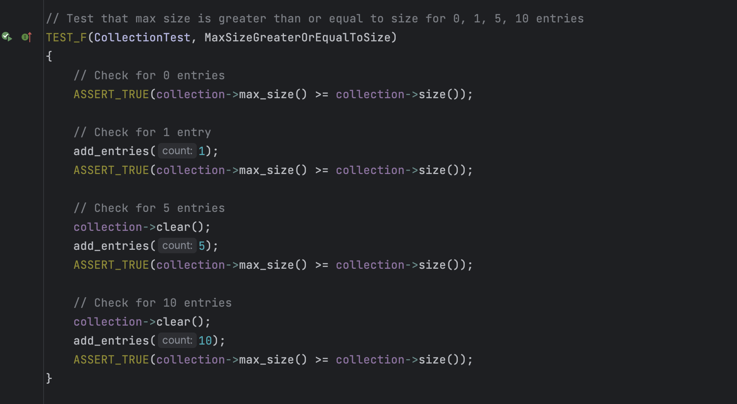
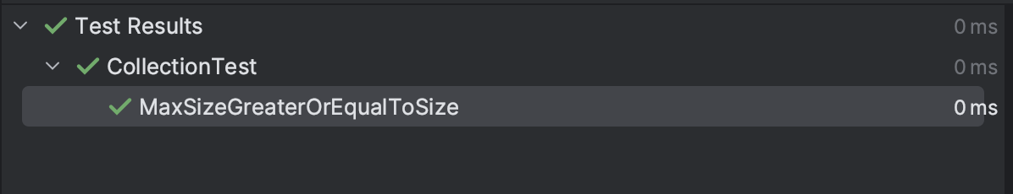
Unit Testing: MaxSizeGreaterOrEqualToSize
This Unit Test tests that the max size is greater than or equal to size for 0, 1, 5, 10 entries

Slide 11
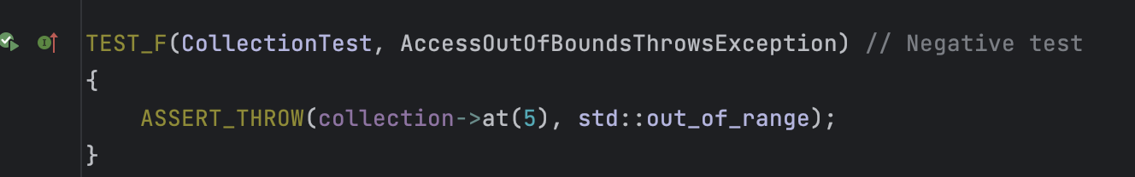
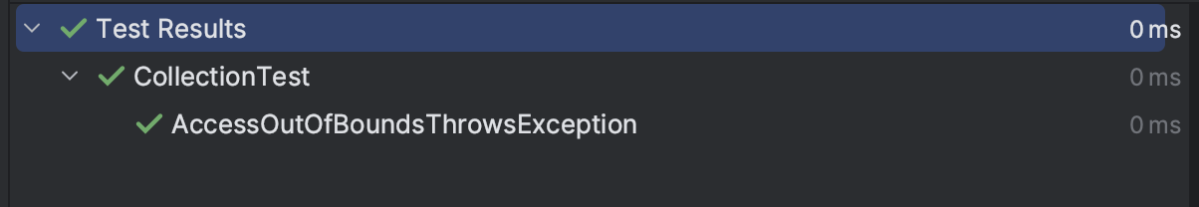
Unit Testing: AccessOutOfBoundsThrowException
This Unit Test is a negative test that tries to access an index at (5) which does not exist in the collection, expecting an out-of-range exception. If no exception is thrown, the test will fail.

Slide 12
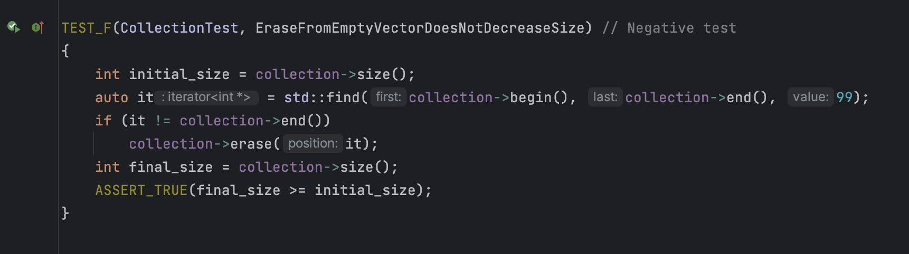
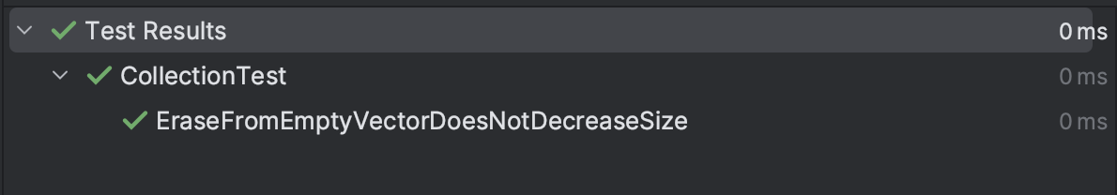
Unit Testing: EraseFromEmptyVectorDoesNotDecreaseSize
This Unit Test is a negative test checks if the collection size decreases when attempting to erase an element from an empty collection

Slide 13

AUTOMATION SUMMARY

Slide 14
TOOLS
The DevSecOps pipeline is a continuous integration/continuous delivery (CI/CD) pipeline that integrates security practices and tooling throughout the entirety of the software development lifecycle. With DevSecOps, security is not an afterthought, but rather a key consideration from the beginning stages of the development process.
Tools:
SAST : Static application testing scans the source code for potential security vulnerabilities. This tool is used during the development phase.
DAST : Dynamic application security testing tests the running application for vulnerabilities. This tool is used during the testing phase.
IaC : Infrastructure as code scans the infrastructure files for any security vulnerabilities. This tool is used during the development phase.
SOAR : Security orchestration, automation, and response automates the security incident response process. This tool is used during the production phase.
LDAP : Lightweight Directory Access Protocol is used to query information rapidly. LDAP controls the access and maintenance of the static data. This tool is used during the development and production phase.
AD : Active directory is used to store sensitive information. This tool is used in the deployment phase.

Slide 15
RISKS AND BENEFITS
Security issues can range from minor vulnerabilities to serious threats or attacks on a system which could compromise the integrity and availability of the system. These security issues could lead to identity theft, financial loses, data breaches, brute force attacks, and affect the reputation of the institution.
A resolution that is immediate could involve identifying the issue or vulnerability, creating a patch, testing the patch, and deploying the patch across the entirety of the system. In this resolution the team would increase monitoring, improve the incident response plan in case of another breach and implement more secure protocols. The risks and benefits of an immediate resolution are that fixing the security issue prevents the potential exploits and mitigates the risks that are associated with an attack. A potential risk could be when deploying the patch, it creates system instability, and incompatibility with the software and system.
A resolution that is delayed allows for the fix to be thoroughly tested and the security issue to be studied allowing for a complete and stable solution. The drawback of waiting are that attacks could continue to occur, damages will increase, the loss of customer trust, legal issues with multiple governments worldwide, and the reputational harm to the organization.
Having to pick between an immediate resolution or a delayed one often requires that the team collect information on how big the attack is and what part of the organization is being attacked, to determine if a quick patch will be enough to stop the security issue or if the team will need to create a more stable solution, acknowledging that the security issue could cause additional harm.
To avoid a security issue the company should employ a zero-trust policy model, perform thorough risk assessments on the system and any vulnerabilities that have been found, implement an emergency patch management process that identifies, installs and verifies the patch is working, auditing on a regular basis to ensure the team is identifying any vulnerabilities before they become a security issue.

Slide 16
RECOMMENDATIONS
Security policies are a set of rules that an organization puts in place to protect its data, infrastructure and systems, based on the risk and threats that they face. The organization would perform a risk assessment, to understand any potential risks and threats the organization faces, so they could focus on the areas that are most vulnerable or areas that contain sensitive data. The security policy should cover all aspects of the organization, including network security, access control, data security, compliance and incident response. The organization should encrypt every piece of data, create a triple-a framework, run unit testing on the code, and use external tools or companies to run vulnerability checks. Every employee within the organization needs to understand the security policies and they should be provided training to ensure that the policies are understood and followed. Management needs to enforce and monitor the compliance of the policies to ensure their effectiveness. Lastly, the policies should be reviewed and updated based on the landscape and threats of the organization.
A real-world example of why it is essential for a company to have security policies in place is the Yahoo data breach that occurred between the years 2013 and 2014. The breach was not disclosed until 2016, resulting in the theft of personal information that affected an estimated 3 billion users. Yahoo lacked the proper security measures, the employees were not properly trained which was the root of the attack, due to an employee falling for a spear-phishing email. Yahoo did not contain an incident response plan which damaged their reputation and trust with the user base. Yahoo did not perform regular security audits that could have discovered the breach sooner and they did contain any type of data classification or management system allows the hackers to have access the user information that included names, email addresses, telephone numbers, DOB, and passwords.

Slide 17
CONCLUSIONS
Secure coding standards are a set of rules and guidelines like those provided by OWASP, SANS or CERT, that developers could follow to write and produce more secure code. These standards can help the developer prevent some of the most common security vulnerabilities such as SQL injection, buffer overflows, and cross-site scripting.
To identify threats and vulnerabilities it is essential to implement and follow secure coding and design practices, including secure language constructs, defense in depth which will create multiple layers of security with the hopes of preventing an attack on the system, use safe API’s, validate all user input from known and unknown sources utilizing a zero-trust policy , secure session management, least privilege principles, preventing code injection, and fail-safe defaults.
Throughout the SDLC development process the team should regularly test the software for any security weaknesses to identify and fix those vulnerabilities. The testing would include unit testing, integration testing, black box testing, system testing, and penetration testing. Vulnerability scanner should be used to scan the software/code for security vulnerabilities which could have been missed by the other types of testing.
The organization should enforce DevSecOps secure coding methods to ensure that the infrastructure being built is efficient as well as secure.
As you could see security should be one of the main components of the entire system to ensure the safety of the organization all while gaining a reputation for being a company that everyone who trust.

Slide 18
REFERENCES
Wikipedia contributors. (2023). Yahoo! data breaches. Wikipedia. https://en.wikipedia.org/wiki/Yahoo!_data_breaches
SEI CERT C++ Coding Standard - SEI CERT C++ Coding Standard - Confluence. (n.d.). https://wiki.sei.cmu.edu/confluence/pages/viewpage.action?pageId=88046682

